Slide 1
DIABETES PREDICTION USING MACHINE LEARNING
R. SREVARDHANI
2019506095
MODULE IMPLEMENTED: DATA VISUALIZATION AND FEATURE ENGINEERING AND MODEL BUILDING USING RANDOM FOREST.
Plot different graphs- data visualization with suitable codes.
Outlier observation analysis by IQR and Z SCORE method.
Add logical new categorical variables to the dataset.
Convert categorical variable to numeric variable by label encoding and one hot encoding method.
Build a random forest classifier.
Evaluate the accuracy of the model.

Slide 2
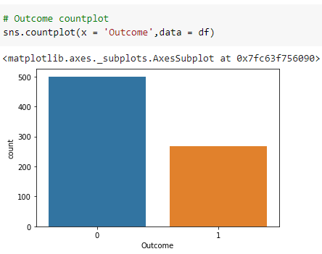
DATA VISUALIZATION:
DATA STRUCTURE USED: Pandas DataFrame
With the help of data visualization, we can see how the data looks like and what kind of correlation is held by the attributes of data. It is the fastest way to see if the features correspond to the output. Visualization of data is an imperative aspect that helps to understand data and also explain the data to others.
COUNTPLOT:
Seaborn library has a function countplot() for creating countplot using sns.countplot() function. One easy way to visualize the counts of observations for outcome type is to create a count plot.
OBSERVATION:
We can observe that the count of 0 outcome that is count of diabetes negative is more than diabetes positive which is denoted as 1.

Slide 3
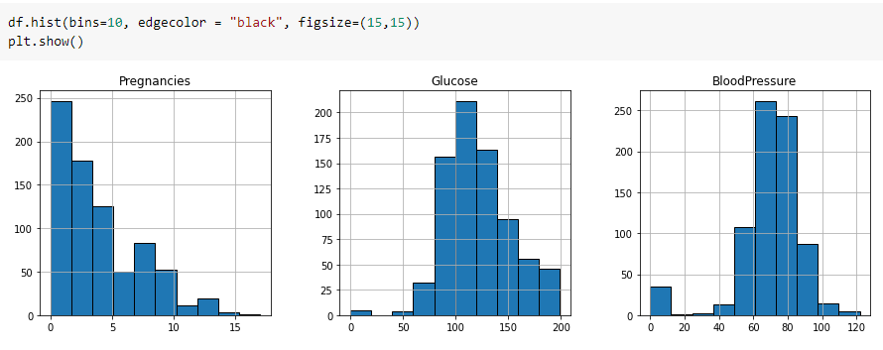
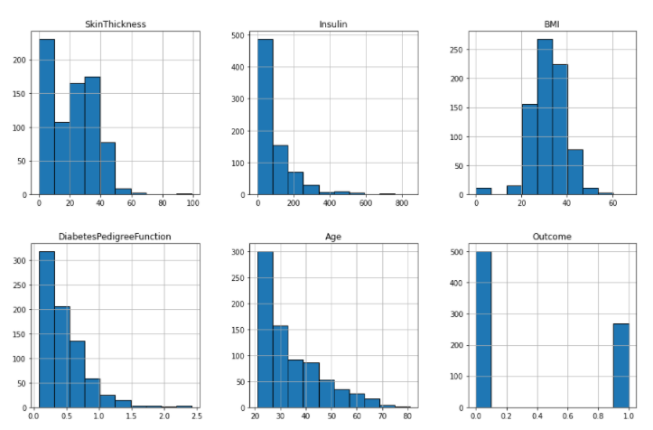
UNIVARIATE PLOTS:
HISTOGRAMS:
Histograms group the data in bins and is the fastest way to get idea about the distribution of each attribute in dataset. It provides us a count of the number of observations in each bin created for visualization.
OBSERVATION:
The output shows that the histogram for each attribute in the dataset is created. From this, we can observe that perhaps Age, Insulin and DiabetesPedigreeFunction attributes may have exponential distribution while BMI and Glucose have Gaussian distribution.

Slide 4
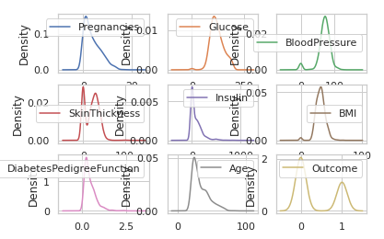
2. DENSITY PLOTS:
Density plots is also like histogram but having a smooth curve drawn through the top of each bin. We can call them as abstracted histograms and matplotlib are used for plotting them.
3. BOX AND WHISKER PLOTS:
Box and Whisker plots, also called boxplots in short, is another useful technique to review the distribution of each attribute’s distribution and Seaborn library is used.
The dots outside the whiskers signifies the outlier values. Outlier values would be 1.5 times greater than the size of the spread of the middle data.

Slide 5
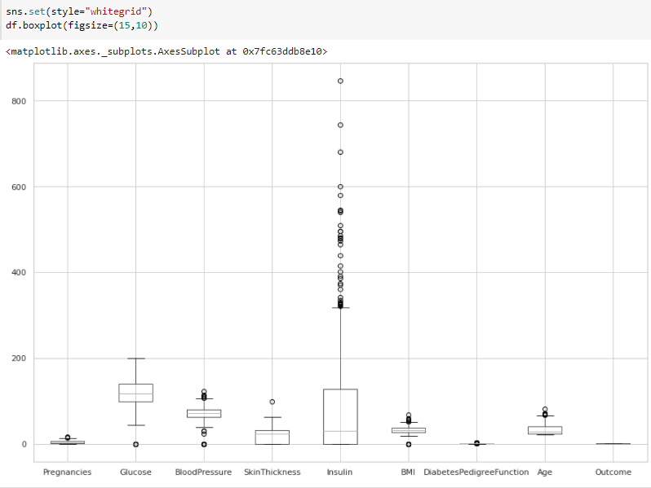
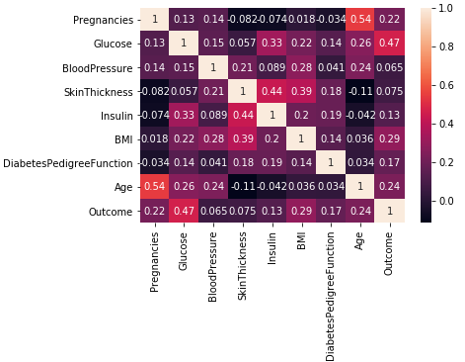
MULTIVARIATE PLOTS:
1. CORRELATION MATRIX PLOT: Seaborn library
Correlation is an indication about the changes between two variables. It ranges from -1 to +1, Positive value indicate positive association and negative value indicate negative association.
OBSERVATION:
Glucose, BMI, Age, Pregnancies are the top 4 features that are related to the outcome. We can also see that it is symmetrical i.e. the bottom left is same as the top right. It is also observed that each variable is positively correlated with each other.

Slide 6
2. SCATTER MATRIX PLOT:
Scatter plots shows how much one variable is affected by another or the relationship between them with the help of dots in two dimensions. Scatter plots are very much like line graphs in the concept that they use horizontal and vertical axes to plot data points.
Python script will generate and plot Scatter matrix for the Pima Indian Diabetes dataset. It can be generated with the help of scatter_matrix() function on Pandas DataFrame and plotted with the help of pyplot.
PAIR PLOT:
Pairplot visualizes given data to find the relationship between them. Pairplot provides a high-level interface for drawing attractive and informative statistical graphics. The pairs plot builds on two basic figures, the histogram and the scatter plot. The histogram on the diagonal allows us to see the distribution of a single variable while the scatter plots on the upper and lower triangles show the relationship between two variables. The matplotlib library is used for plotting them.

Slide 7
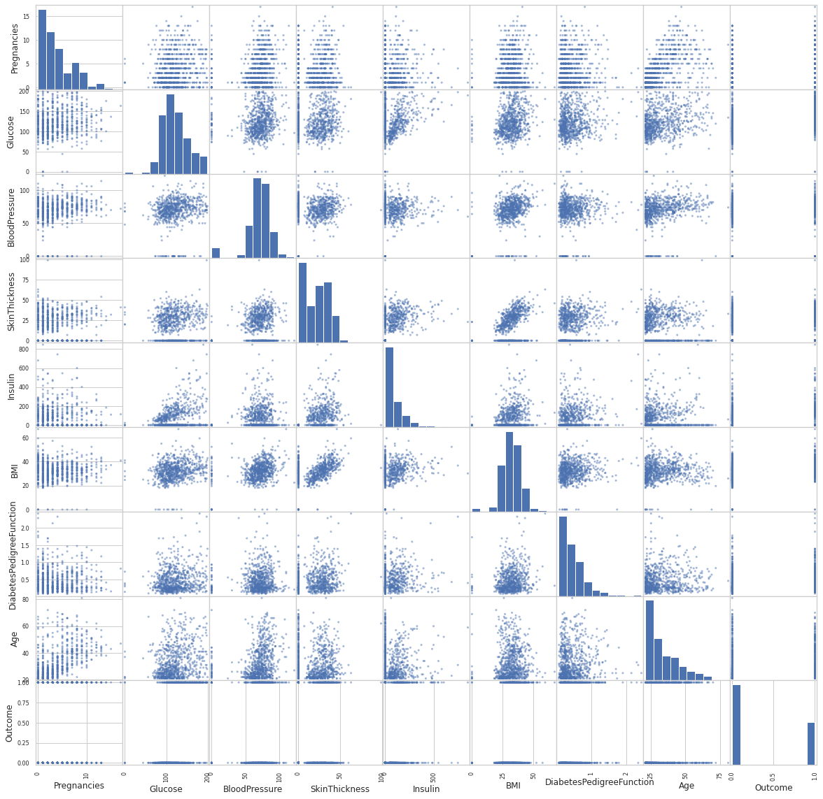
OBSERVATION:
We can observe the variations in each plot. The plots are in matrix format where the row name represents x axis and column name represents the y axis. The main-diagonal subplots are the univariate histograms (distributions) for each attribute.
We can observe that there is a positive linear relation between the points. That is, the value of y increases with the value of x.

Slide 8
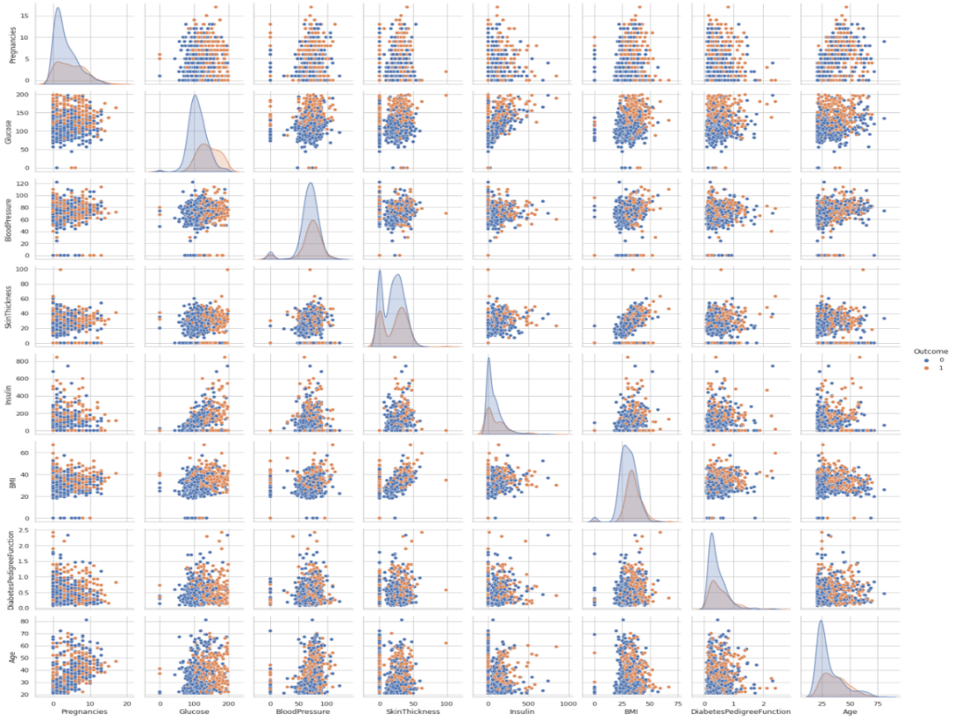
OBSERVATION:
We can observe that there is a positive correlation between various features:
Glucose level increases with Age.
Insulin level increases with Glucose level.
Insulin level increases with Age.
Slight increase in BloodPressure with Age.
Slight increase in BloodPressure with Insulin.
Skin thickness increases with insulin.
Skin thickness increases with BMI.

Slide 9
FEATURE ENGINEERING:
Process of extracting useful features from a raw dataset using mathematics, statistics and domain knowledge. Algorithms require features with some specific characteristic to work properly. It allows avoiding overfitting the model despite providing many input features. The ultimate goal is to get the best results from the algorithms.
DATA STRUCTURE USED: Numpy Pandas
OUTLIER OBSERVATION ANALYSIS:
IQR METHOD: Libraries used- Seaborn and numpy
The interquartile range (IQR), also called the middle 50%, is a measure of statistical dispersion, being equal to the difference between 75th and 25th percentiles, or between upper and lower quartiles, IQR = Q3 − Q1; these quartiles can be clearly seen on a box plot on the data.
This removed the outliers from the dataset. After the removal of the outliers, the dataset has decreased by 178 records. All the outliers that are datapoints lesser than lower limit (Q1 - 1.5*IQR) and datapoints that are larger than the upper limit (Q3 + 1.5*IQR) are removed.

Slide 10
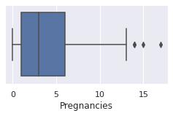
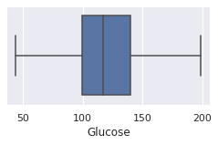
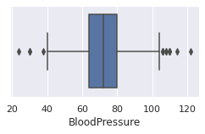
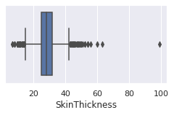
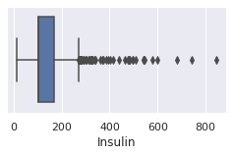
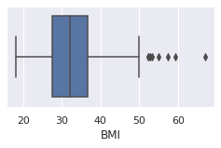
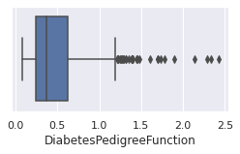
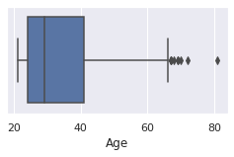
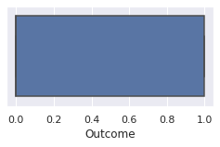
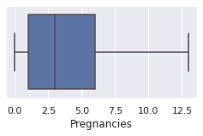
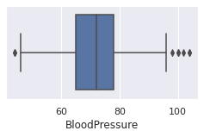
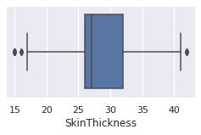
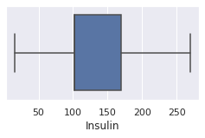
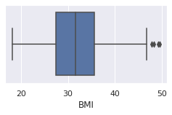
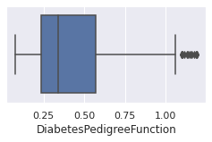
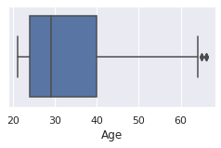
Boxplots are plotted for each feature to visualize the outliers:
We could observe that there is no outliers for Glucose and Outcome features and there are outliers for all other features.
Boxplots are plotted after the removal of the outliers:
We could observe that the outliers of each feature are removed to a large extent.

Slide 11
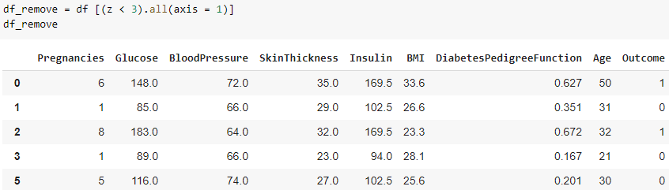
Z SCORE METHOD: Libraries used- numpy
Z score, also called standard score is another method that can be used to remove outliers. This score helps to understand if a data value is greater or smaller than mean and how far away it is from the mean. More specifically, Z score tells how many standard deviations away a data point is from the mean.
Z score = (x -mean) / std. deviation.
If the z score of a data point is more than 3, it indicates that the data point is quite different from the other data points. Such a data point can be an outlier. Z-score function defined in scipy library to detect the outliers.
All the outliers are removed, for example, As z[4][6] have a Z-score higher than 3, the data point 4th record on column 6 is an outlier and it is deleted, thus we got the clean data. After the removal of the outliers, the dataset got reduced by 49 records.

Slide 12

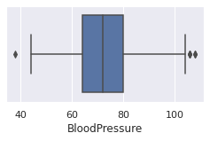
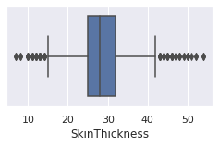
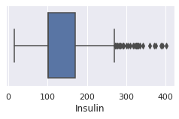
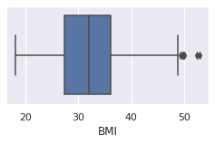
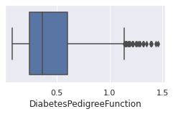
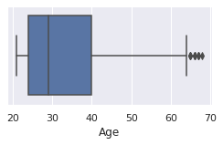
ADDITION OF NEW CATEGORICAL VARIABLES:
Creating new variables is important for models. But we need to create a logical new variable. For this data set, some new variables are created according to BMI, Insulin and Glucose variables. Max and Min values of each variable are found and some ranges are determined and categorical variables are assigned to these variables. These categorical variable is ordinal- Ordinal categorical attributes have some sense or notion of order amongst its values.

Slide 13
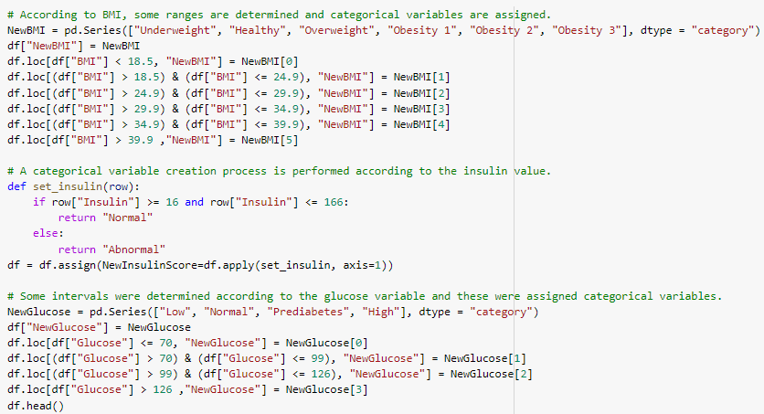
According to BMI, 6 different ranges -Underweight, Healthy, Overweight, Obesity 1, Obesity 2, Obesity 3 are determined and categorical variable NewBMI is assigned.
A categorial variable creation process is performed according to the insulin value. NewInsulinScore has 2 range- Normal and Abnormal and it is an ordinal categorical variable.
Four intervals- Low, Normal, Prediabetes, High were determined according to the glucose variable and these were assigned to an ordinal categorical variable, NewGlucose.

Slide 14
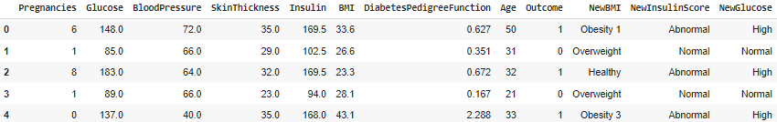
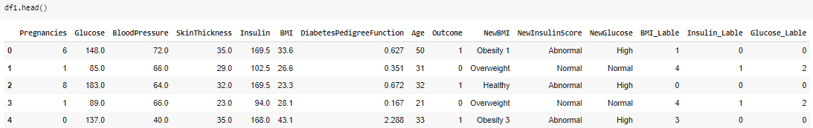
We can now observe three categorical variables that are created. Categorical variables in the data set should be converted into numerical values. For this reason, these transformation processes are performed with 2 methods: Label Encoding and One Hot Encoding method.
LABEL ENCODING:
Label Encoding refers to converting the labels into a numeric form so as to convert them into the machine-readable form. Here, each category is assigned a value from 1 to n, where n is the number of labels for the categorical feature.
Now, the categorical variables can be dropped.

Slide 15
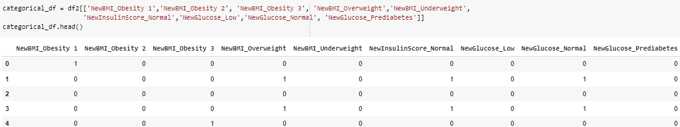
ONE-HOT ENCODING:
One-hot encoding is one of the most common encoding methods in machine learning. This method spreads the values in a column to multiple flag columns and assigns 0 or 1 to them. These binary values express the relationship between grouped and encoded column.
All categorical variables in the dataset are converted into numeric values by encoding.
By trying different combinations of ZSCORE AND IQR method (outlier detection and removal) and LABEL ENCODING and ONE HOT ENCODING (conversion of categorical variable to numeric variable), it was found that the ZSCORE method and LABEL ENCODING method gives a higher accuracy for all the models.

Slide 16
RANDOM FOREST:
Random Forest is a popular machine learning algorithm that belongs to the supervised learning technique. It can be used for both Classification and Regression problems in ML. It is based on the concept of ensemble learning, which is a process of combining multiple classifiers to solve a complex problem and to improve the performance of the model.
As the name suggests, "Random Forest is a classifier that contains a number of decision trees on various subsets of the given dataset and takes the average to improve the predictive accuracy of that dataset." Instead of relying on one decision tree, the random forest takes the prediction from each tree and based on the majority votes of predictions, and it predicts the final output. The greater number of trees in the forest leads to higher accuracy and prevents the problem of overfitting.
ADVANTAGES OF RANDOM FOREST:
Random Forest is capable of performing both Classification and Regression tasks.
It is capable of handling large datasets with high dimensionality.
It enhances the accuracy of the model and prevents the overfitting issue

Slide 17
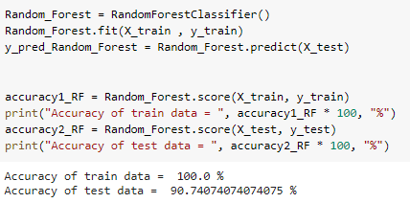
After the completion of data pre-processing, feature engineering and label encoding, the accuracy of the random forest algorithm has been found and this has been increased compared with the implementation of original dataset.
RESULT:
Thus, I have implemented my module, DATA VISUALIZATION using different plots, FEATURE ENGINEERING by outlier detection and removal, adding new variables and encoding the categorical variables and model building using RANDOM FOREST. Thus, finally we got a dataset which gives better results.

